Slide 1
DFA Minimization

Slide 2
DFA minimization is the task of transforming a given deterministic finite automaton (DFA) into an equivalent DFA that has a minimum number of states.
There are two classes of states that can be removed or merged from the original DFA without affecting the language it accepts to minimize it.
Unreachable states are the states that are not reachable from the initial state of the DFA, for any input string.
Nondistinguishable states are those that cannot be distinguished from one another for any input string.

Slide 3
Find all equvalance states
Step 1(Find 0 equvalance state): We will divide Q (set of states) into two sets. One set will contain all final states and other set will contain non-final states.
Step 2(Find 1 equvalance state):Give every input to all the states and find whether they are in the same set.
If they are, means the states are 1 eqivalent
Step 3(Find 2 equvalance state)
Step 3(Find 2 equvalance state)
........Continue till you get same set of state

Slide 4
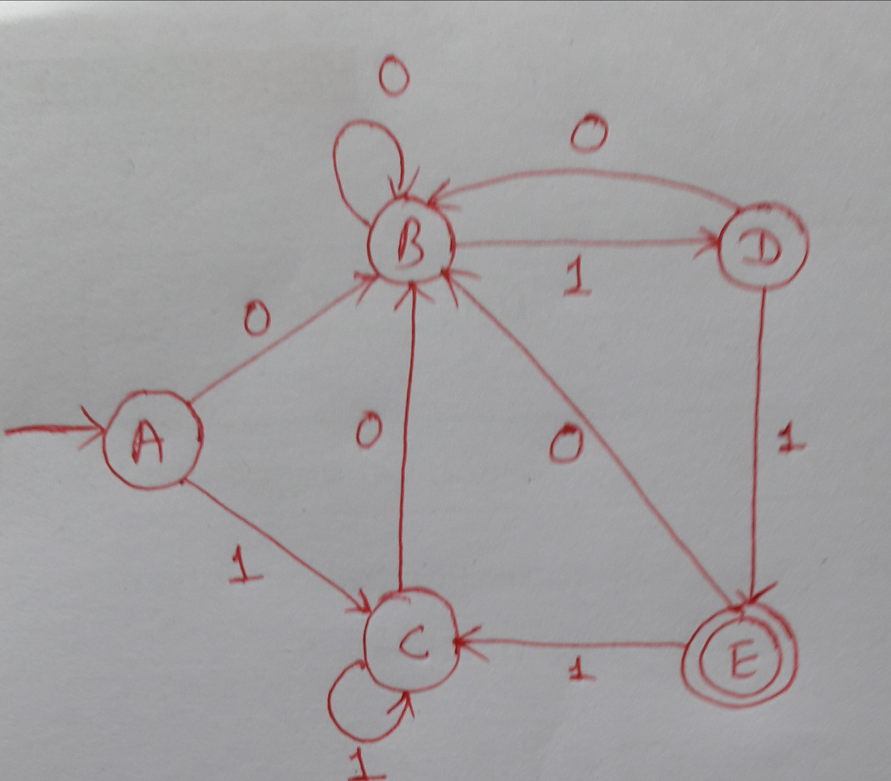
 | 0 | 1
A | B | C
B | B | D
C | B | C
D | B | E
E | B | C
Step 1(Find 0 Eqivalence): {A,B,C,D} {E}
Step 2(Find 1 equvalance ): {A, B, C} {D} {E}
Step 3(Find 2 equvalance ): {A,C} {B} {D} {E}
Step 4(Find 3 equvalance state): {A,C} {B} {D} {E}
So here on step 3 & 4 we are getting same set of state so need to stop here, if you continue you will always get same set of state.
Now draw the DFA with {A,C} as a single state

Slide 5
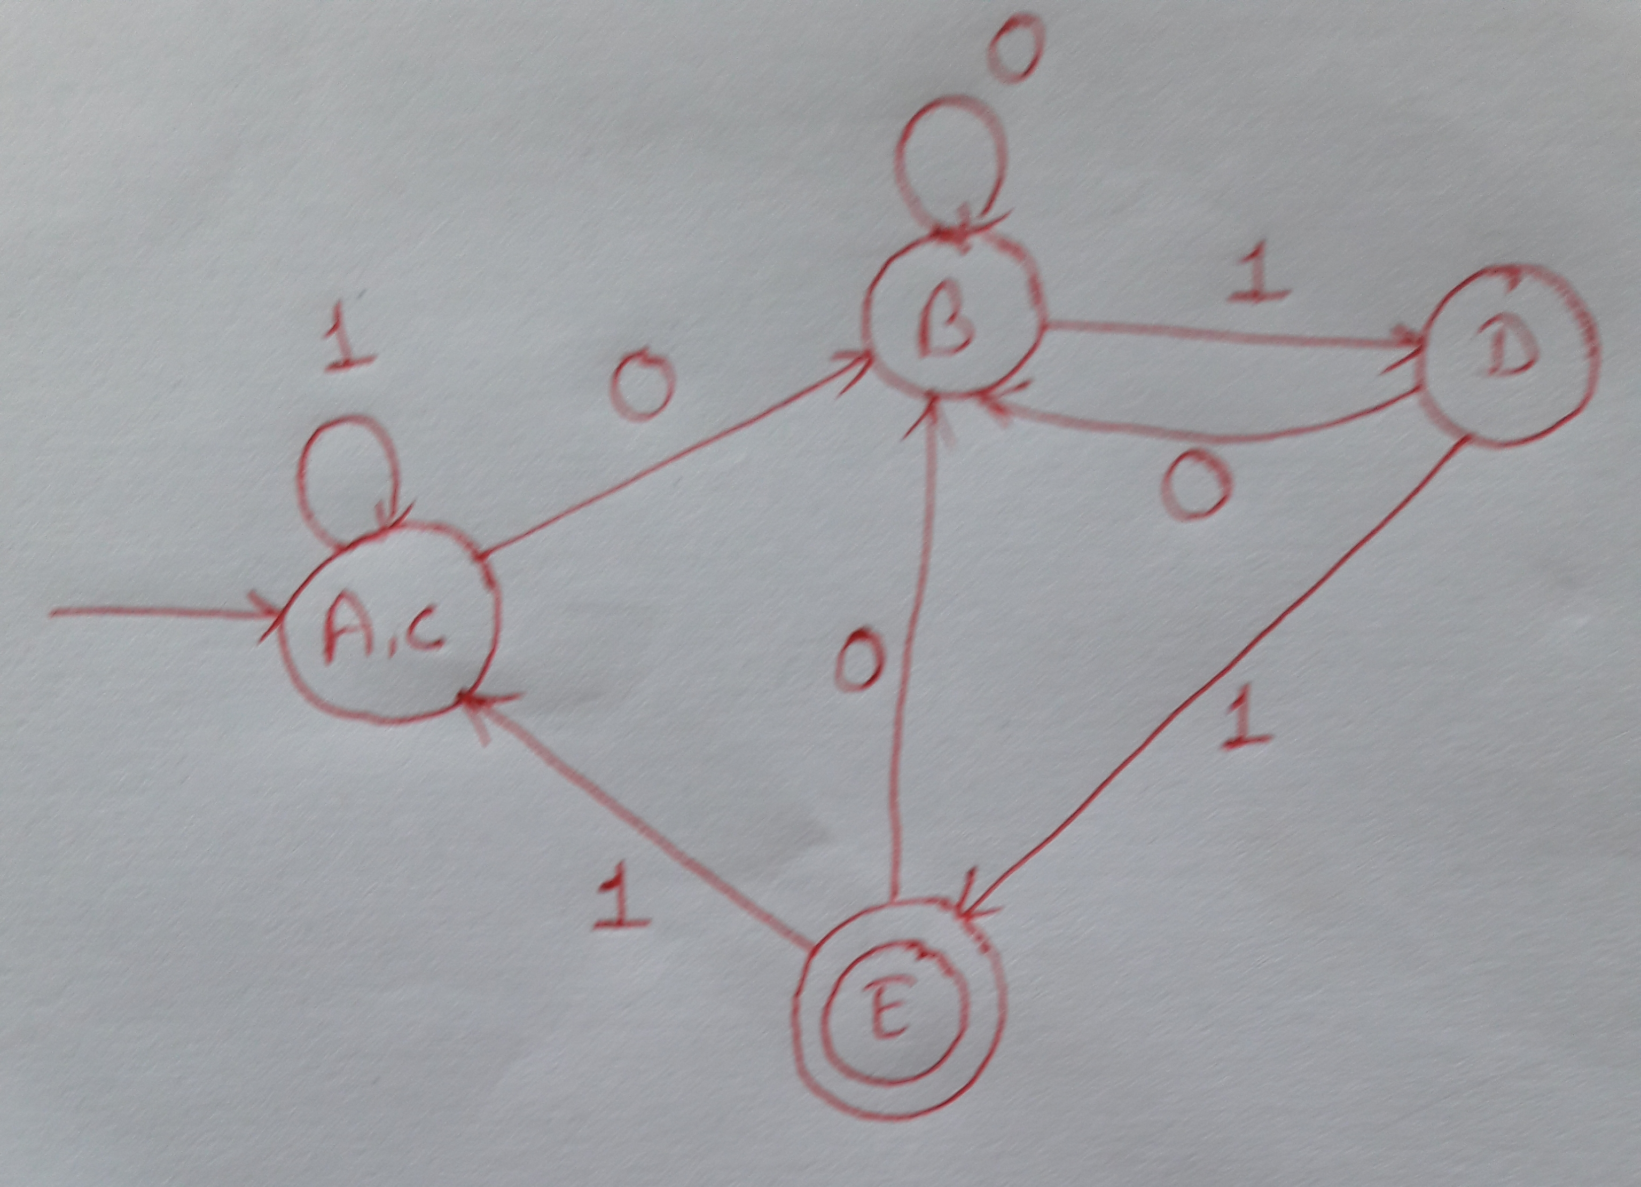
 | 0 | 1
A | B | C
B | B | D
C | B | C
D | B | E
E | B | C

Slide 6
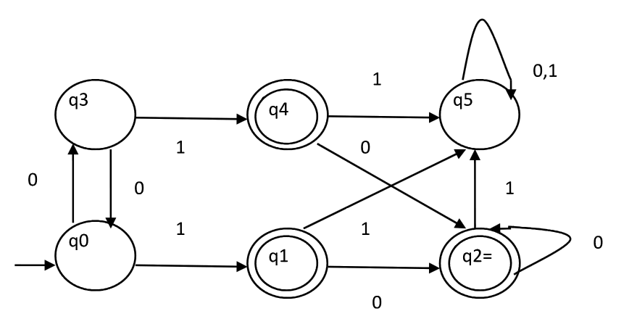
 | 0 | 1
q0 | q3 | q1
q1 | q2 | q5
q2 | q2 | q5
q3 | q0 | q4
q4 | q2 | q5
q5 | q5 | q5
Step 1(find 0 equivalence):{q0,q3,q5} {q1,q2,q4}
Step 2(find 1 equivalence):{q0,q3} {q5} {q1,q2,q4}
Step 3(find 2 equivalence): {q0,q3} {q5} {q1,q2,q4}

Slide 7
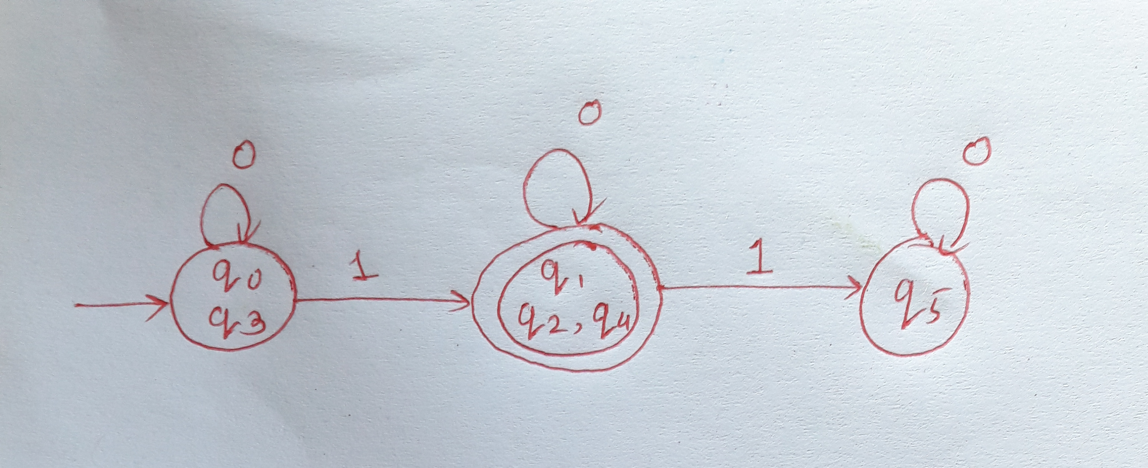
 | 0 | 1
q0 | q3 | q1
q1 | q2 | q5
q2 | q2 | q5
q3 | q0 | q4
q4 | q2 | q5
q5 | q5 | q5
{qo,q3} {q1,q2,q4} {q5}

